Slide 1
Using interactive video to flip the classroom:
Improving the efficiency of teacher and student time…
Michael Bush
Brigham Young University

Slide 2
Overview of Presentation
An introduction to Ayamel
  What it is
  Why it is important
A brief review of the challenge and the theory involved
A short technology overview
Current implementations of Ayamel

Slide 3
Demonstrations
Feature-length movie from 5th semester French conversation class
Quizlet.com
Arabic Encounters
BYUtv (Studio C from YouTube)
Unidos from Pearson World Languages
YouTube Video from Russian 322

Slide 4
Background of Ayamel
$300,000 Federal grant from The Language Flagship to
American Councils for International Education
  $100K to BYU as well as BYU Contibutions
  Ayamel.org for the API versus Ayamel@BYU
Started as Flagship Media Library
  Now IML (Ayamel) instead of FML (Urban Dictionary…)
Primary design premise for Ayamel
  Let’s build YouTube on steroids to support Language Learning!

Slide 5
Ayamel
Makes media easily available to learners and teachers
  Outside the classroom
  Or even inside the classroom!
Maximizes the benefit of the classroom experience
Provides accountability for out-of-class activities
Provides excellent platform for language acquisition research
Implements crowd-sourcing for network effects (Metcalfe’s Law)

Slide 6
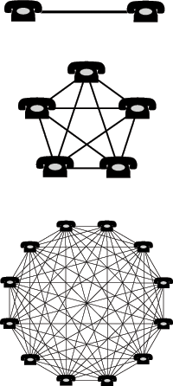
Value of the Network: n²
Where n is the number of connections (telephones in this case)
^{(Metcalfe’s Law)}
Wikipedia: Network Effect

Slide 7
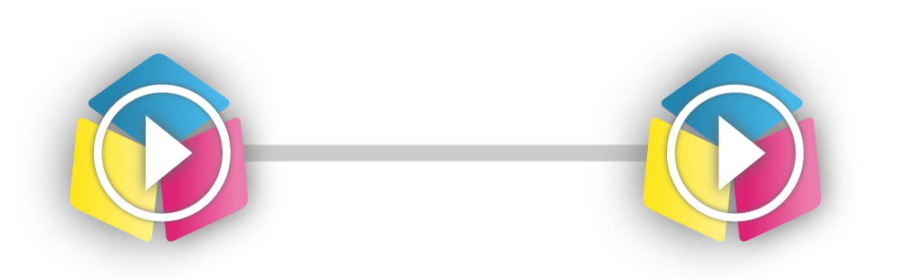
Ayamel & The Network Effect

Slide 8
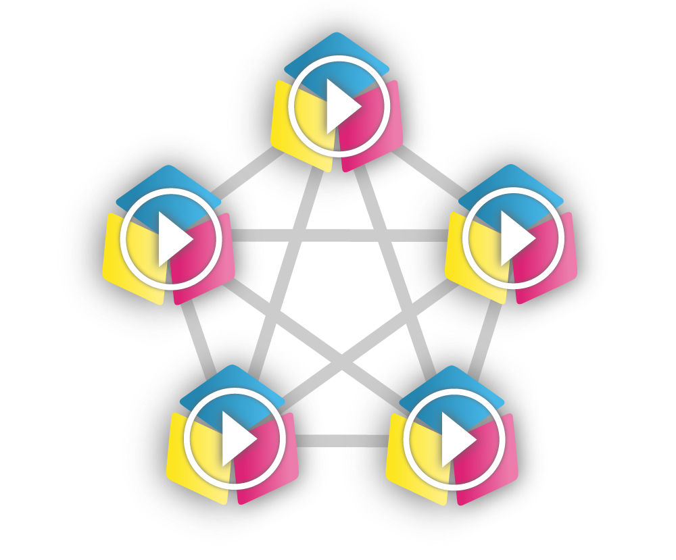
Ayamel & The Network Effect

Slide 9
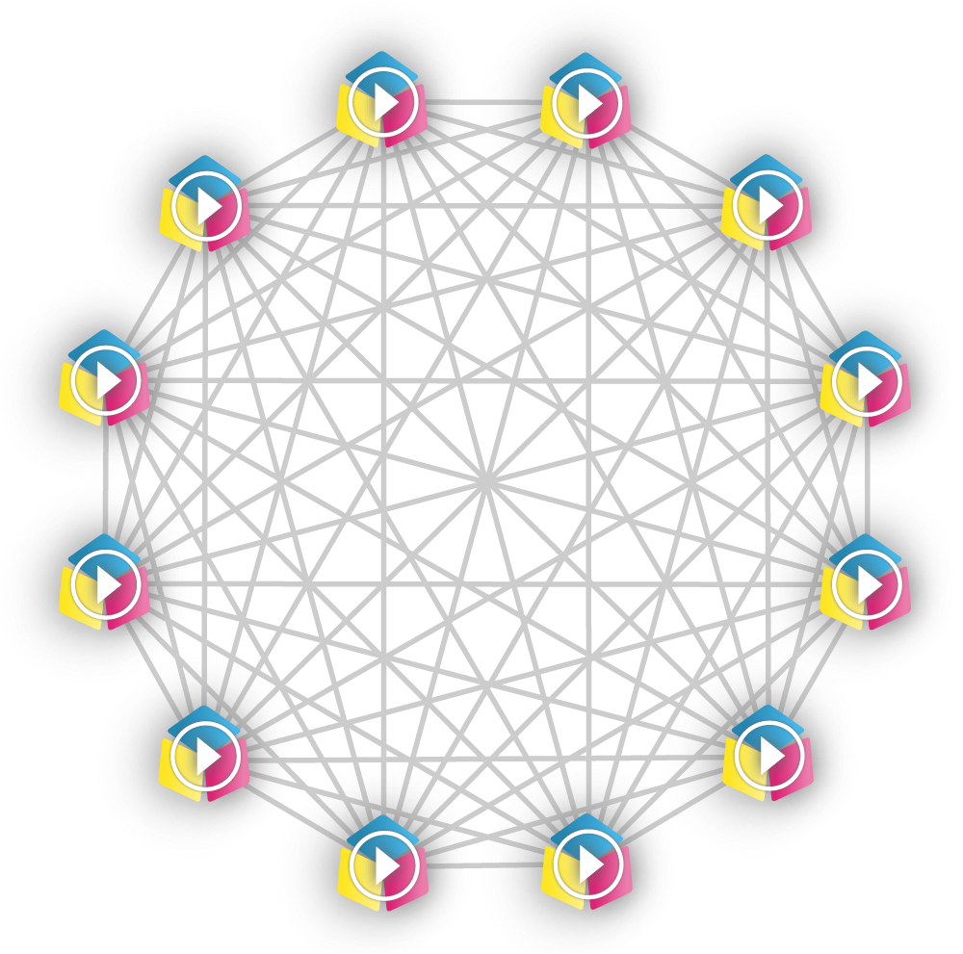
Ayamel & The Network Effect
Notes:
https://byu.az1.qualtrics.com/SE/?SID=SV_20kDZDLplJgKTbL

Slide 10
Ayamel
Provides a truly multimedia experience
for target language content and annotations
  Video
  Audio
  Graphics, and
  Text

Slide 11
Ayamel
Connects to Learning Management Systems via LTI
  Canvas from Instructure
  BrainHoney from Agilix
  Moodle
  BYU Learning Suite
Connects to other tools such as Quizlet.com

Slide 12
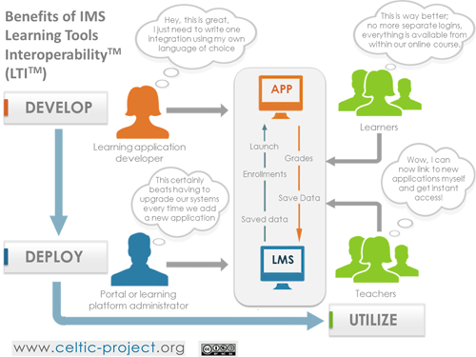

Slide 13
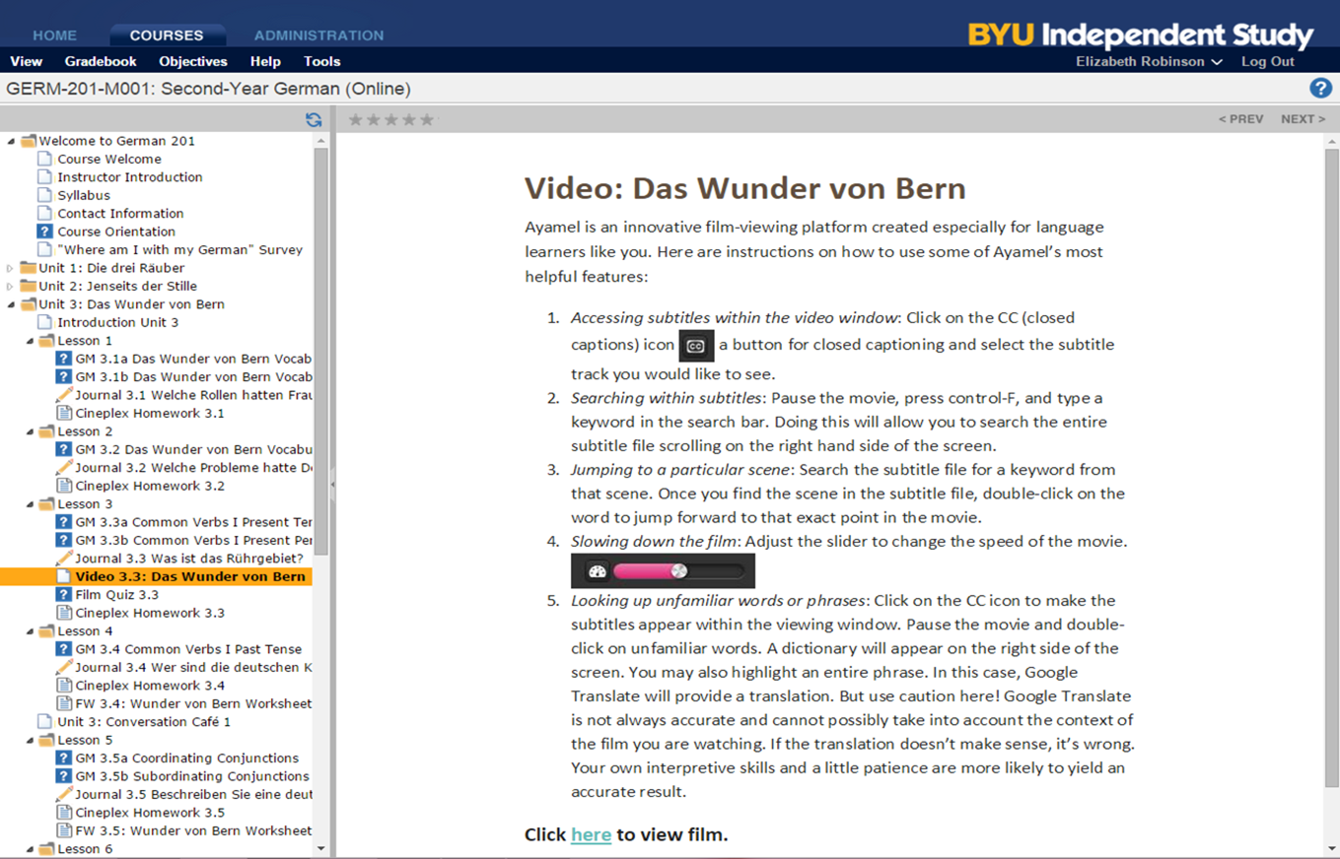

Slide 14
Ayamel
Streams video from numerous sources
  Standard Web servers
  YouTube
  Brightcove
  Ooyala
  Vimeo
  Wowza (recently added with Scola.org for Utah Dual Language Immersion)

Slide 15
Today’s General Assumptions
About Learning
Technology can play a role.
New learning must be related to the old (i.e. what is known): Meaningful learning over rote
Learner centricity is an important concept.
The most important learning variable is time on task.

Slide 16
Vision of Learner Centricity
Bloom’s 2-Sigma Difference (1984)

Slide 17
Stories (narrative) can play a big role
We love to tell stories, and we love to have others tell us stories!
Thousands of years of experience (from the campfire to movies and television) demonstrate that stories are important to human existence.
They are also important to how our minds work:
  We understand the world around us in terms of stories we have already understood!

Slide 18
Why is Ayamel important?
Game changer?
Pendulums will swing and band wagons will roll, but no silver bullet has ever been or ever will be a reality. Acquiring a language is hard work that takes literally thousands of hours.
Notes:
I will come back to the thousands of hours idea in a moment…

Slide 19
The Challenge of Language Learning
Learning language is perhaps the most complex of all human undertakings, characterized by a seemingly bizarre paradox. While the attainment of “perfection” is natural for a normal, growing child, it is virtually impossible for an adult.
Notes:
Young people leave the Missionary Training Center adjacent to the BYU campus after a couple of months of training. They might feel confident about their progress, but their first encounter with a six-year-old quickly deflates their ego: “I mean I am an adult, and that is just a kid, right?!?”

Slide 20
The importance of Time on Task
Gladwell’s 10,000-Hour Rule:
  The key to success in any field is, to a large extent, a matter of practicing a specific task for a total of around 10,000 hours.
    Wikipedia (Outliers, book by Malcolm Gladwell)
A six-year-old…
  Starts school with 29,200 hours of L1 language acquisition under their belt
So, how do we motivate and engage our students to put in the required time?

Slide 21
Integrating the activities of the
Technology and the Teacher
Technology does not replace teachers.
Teachers who use technology replace teachers who don’t.
If the technology can do something useful, don’t waste teacher time on that…
There are other things that teachers do better than the technology.
  And these activities are more fun for the teachers anyway!

Slide 22
Language and the mind: the theory
All input (especially repetitive input) must be meaningful.
Repetition should not mean word-for-word parroting
Repetition in pedagogy should not be limited to the visual and audio elements of reading, video, etc. .
Notes:
(1) Meaningful: learner-initiated focus on specific elements for extra repetition or error correction can be just as valuable as long, uninterrupted presentations of video or text.
(2) Repetition: Words, structures, sounds, and semantic categories should act as a motif, overlaying novel contexts and activities with intrinsic interest and engagement.
(3) Pedagogically appropriate repetition will involve Kinesthetics, cognition, and other productive processes that are self-monitored in the language learner. These comprise a form of input that is every bit as valuable as those that are externally-generated. Because these processes are internal, they are impossible to observe directly and thus difficult to analyze, but they are real nonetheless.

Slide 23
Repeated encounters
Experiencing language
  Using a range of language functions
  In a range of different contexts

Slide 24
The Potential for Using Video...
The arguments for using television technology in the classroom are so convincing that perhaps those not using it should be asked why they have neglected this important aid to second language learning. (Richardson and Scinicariello, Modern Media, 1989)
It’s a great way to tell stories!
No medium was ever cooler!
Yet, it is sorely underused!
Notes:
It is getting cooler all the time!

Slide 25
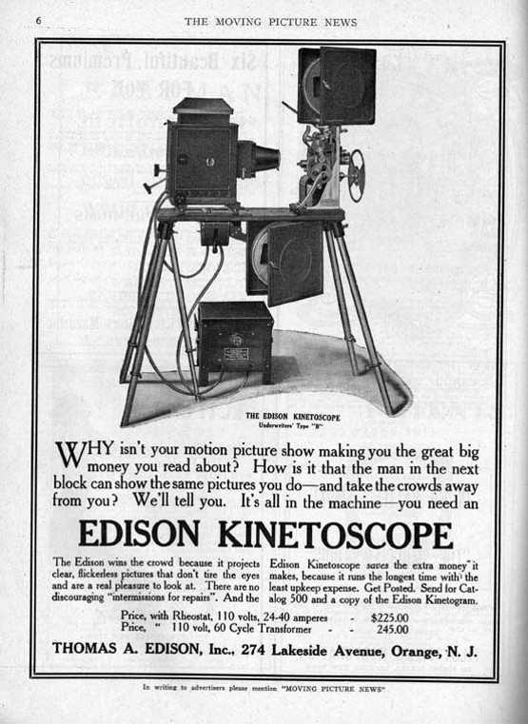
Promises, promises...
“Books will soon be obsolete in the schools and every branch of human knowledge will be taught with the motion picture.”
“The school system will be completely changed in ten years.”
Thomas A. Edison, 1919

Slide 26
The Challenge for Edison?
Words from Paul Saffo (Institute for the Future)
Forecasting is really tough…
  Especially when it involves the future!
When we forecast the future of technology,
  We will be wrong twice...
    We will overestimate the impact in the near term…
    But we will invariably underestimate the impact in the long term!

Slide 27
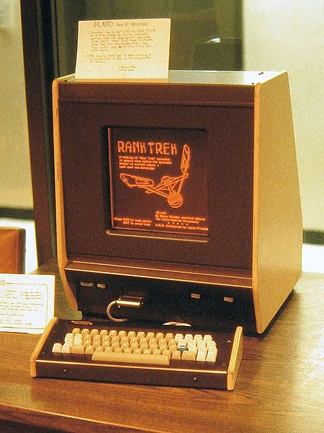
Phases of CALL (TELL) History
Computer-Aided Instruction (1960s-1970s)
  PLATO (University of Illinois Champaign-Urbana)
  TICCIT (Brigham Young University)
Interactive Video (1980s)
  BYU
  US Air Force Academy

Slide 28
Interactive Video
Brigham Young University
  Macario (Annotated movie: 1978)
  Montevidisco (Simulated conversation: FIPSE, 1980)
US Air Force Academy
  Language Learning Center (Interactive videodisc)

Slide 29
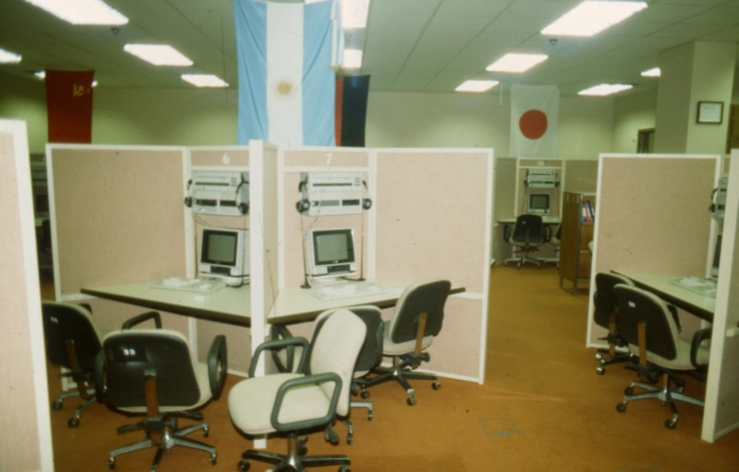
USAFA Language Learning Center

Slide 30
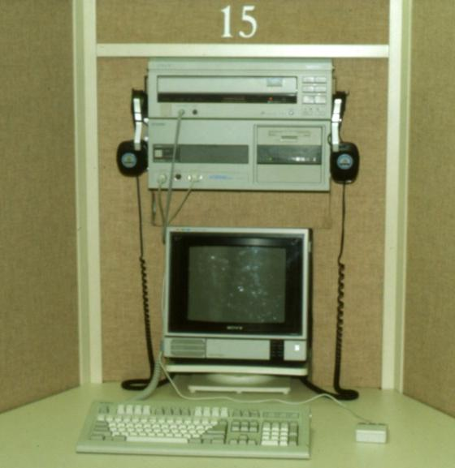
Problem #1?
Price for each workstation
  $8,000 then…
  $12,000 today!

Slide 31
Problem #2?
Hint?
  Think:
    Learner Centricity
Two headsets...
One mouse!!

Slide 32
Brief Anecdote
Krashen and USAFA Software
  “This is okay, but
  “Don’t worry about all this support stuff,
  “Just give them more video!”
Today’s message to Krashen:
  Ayamel broadens the range of learners that can benefit from any given sample of language that will help students acquire the language.

Slide 33
Moore’s Law
Exponential growth in the power of information technology.
Ray Kurzweil: We are merely “at the knee in the curve,”
The notion of exponential advances means that we spend a long time on the left tail of the curve.
Capabilities
Time

Slide 34
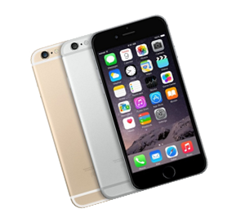
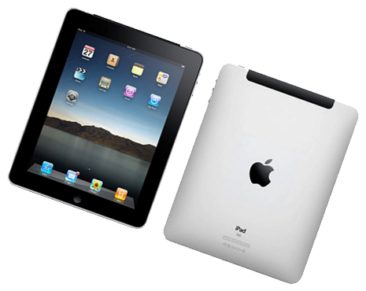
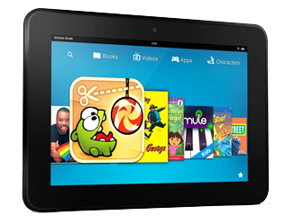
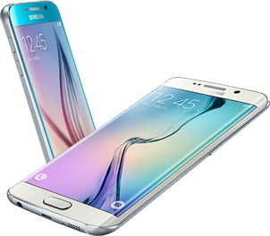

Slide 35
Technical Underpinnings
Open architecture
Client-Server applications
Standards-based:
  HTML5, CSS, JavaScript
Multiple browsers:
  Chrome, Firefox, & Safari
  Internet Explorer (Looking better for future versions, Edge etc....)
Flexible video sources:
  Web server, Brightcove, YouTube, Vimeo, Ooyala, & Wowza

Slide 36
Using Ayamel: A student’s perspective
Learner engagement: Watching video is fun!
Interactive language learning platform
Powerful tools for the student
  Interactive subtitles
  Word list (Quizlet)
  Variable playback speed (helpful when watching content made for native audiences)
  Easy repeat feature

Slide 37
Ayamel and Student Success
Helpful tools for teachers to make content more meaningful for students:
Development tools
  Help pages
  CaptionAider
Automatic definitions
Annotations

Slide 38
Demonstrations
Quizlet.com
Arabic Encounters
BYUtv (Studio C from YouTube)
YouTube Video from Russian 322

Slide 39
Ayamel in a Russian Course
Russian 202 (proficiency intermediate-low to intermediate-mid)
Purpose for use
Provide accessible, authentic input
Provide access to cultural products and perspectives
Promote motivation

Slide 40
Course Design
Pre-Activities
During Activities
Post-activities

Slide 41
Pre-Viewing (In class)
Introducing the video (when it was filmed, popularity in the target culture, etc.)
Asking questions about student experiences similar to what will happen in the video.
Watching video with sound off and deciding what is going on.

Slide 42
During (First viewing)
General questions
Who said what?

Slide 43
During (Second viewing)
Put events in order
True or false questions
Questions on the details of the video

Slide 44
Post Activity 1 (After viewing)
Write a summary
Predict what will happen next
Write a different ending
Move from the video into the lives of the students.

Slide 45
Post-Activity 2 (In class)
What didn’t you understand?
Summarize
Work on grammar and lexicon from the episode
Act out portions of the film

Slide 46
Post-Activity 3
Students write and act out an additional episode that is related to the video

Slide 47
Ayamel in a Russian Course:
Student Perspectives
Ayamel was helpful to me in my study of Russian because
It helps me connect to Russians...It’s an innovative cultural experience.
I was introduced to Russian vocabulary in a fun way which made it easier to retain the new words
I was able to easily access the videos which are a type of immersion that we can access in Provo.

Slide 48
Ayamel in a Russian Course:
Student Perspectives
I enjoyed learning Russian with Ayamel because...
I was able to learn the pronunciation as well as the spelling of the words at the same time.
The situations felt more real than a textbook.
It was great and I hope someone develops an app for kids.

Slide 49
Ayamel in a Russian Course:
Student Perspectives
Using Ayamel in my study of Russian I was able to
get a better grasp on what the movies and cartoons were trying to convey.
learn a lot while enjoying my homework. It was really helpful because it was fun, and I created associations which helped me learn new words.
hear how the phrases were supposed to sound and repeat them as needed.

Slide 50
Ayamel in a Russian Course:
Student Perspectives
Which features of Ayamel did you use most often?
I used the stop and go buttons. It helped SOOO much. Especially search-ability. When you are being tested or quizzed on a movie search-ability is your best friend.
I liked the ability to have subtitles. I also liked that I could search through the transcription for words that I didn’t understand when I first watched the episode.
The box on the side that allowed me to read along. It was nice to be able to get the definitions as well.

Slide 51
Ayamel was helpful to me in my study of Russian because....
I really loved watching Russian cartoons. I don't feel like they are readily available elsewhere. It also helps me connect to Russians.
I memorized a few of the songs from Cheburashka and when I sing them for Russians, they sing along because they grew up with that.
It’s an innovative cultural experience.
I also appreciated the click and stop with the words.

Slide 52
Many thanks!
Michael_Bush@byu.edu

